Slide 1
Marie Skłodowska-Curie actions
Your research career in Europe
Dr. Desislava KOLAROVA
European Commission, Research Executive Agency -Excellent Science Department
8 February 2016, Sofia UNWE

Slide 2
Summary
Policy context: EU2020 - Innovation Union Flagship initiative - Horozon 2020
    Marie Skłodowska-Curie actions in Horizon 2020
    Main features of MSCAs, overview of different actions and their specifics, modalities of participation
    Calls timetable and information on possibilities for experts

Slide 3
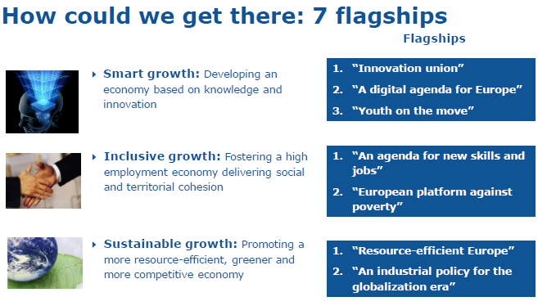
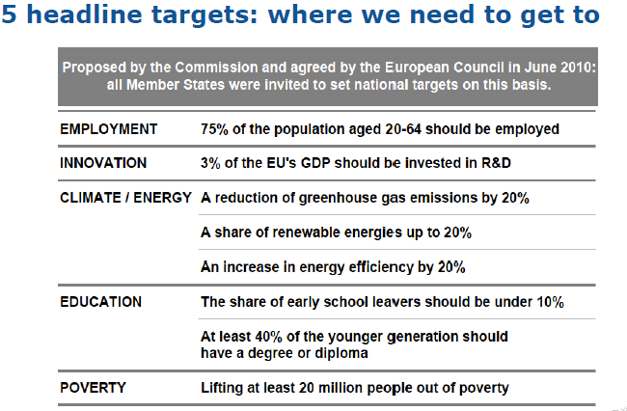
Policy framework
Europe 2020

Slide 4

Horizon 2020
  An integrated programme coupling research to innovation
    Responding to the economic crisis to invest in future jobs and growth
    Addressing people’s concerns about their livelihoods, safety and environment
    Strengthening the EU’s global position in research, innovation and technology

Slide 5
Europe 2020 – Innovation Union priorities
- Regulation 1291/2013 establishing H2020
- Council Decision 2013/743/EU specific programme
- Regulation 1290/2013 Rules for participation
HORIZON 2020
Societal Challenges
Industrial Leadership
Excellent Science
European Research Council
Future and Emerging Technologies
Marie Skłodowska-Curie actions on skills,training and career development € 6.162 billion
Research infrastructures
Horizon 2020 (2014-2020)
Total EU Regulation: € 80 billion over 7 years
Total EURATOM Regulation 2014-2018: 1 603 million euro
2019-2020: 770 million euro
(In current prices)

Slide 6



Europe 2020 Flagship Initiatives
MSCAs &
EU2020 Strategy
Innovation Union
Youth On the Move
Agenda for New Skills and Jobs
  1 million more researchers
  Attract and train young people to become researchers
  Improve quality of doctoral training
  Involve businesses in doctoral training
  Promote researchers mobility across sectors, countries and disciplines
  Attractiveness of European universities
  Stronger links between education, research and innovation
  Equip researchers with relevant skills that will match both public and private sector needs
  Improve career prospects of doctoral candidates

Slide 7
MSCAs – Key Features
Broad definition of industry involvement: participation of businesses (including SMEs) and other socio-economic actors
Internal H2020 synergies with other part of Excellent Science, societal challenges, industrial technologies, EIT, Erasmus for All, Cohesion Policy
Excellent employment and working condition
Gender balance and equal opportunities
Outreach activities and communication

Slide 8
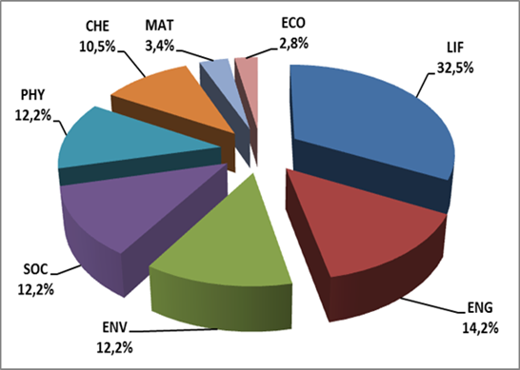
MSCAs
- Key features
Bottom-up approach
    Includes all domains of research and innovation
    > 10.600 projects funded (FP7 2007-2013)
Openness
    No nationality restriction; open to researchers
    at all career stages
    > 50 000 researchers of 141 nationalities
    – 23% from Third Countries (2007-2013)
Mobility
    A global scope with cross-border and cross-sector mobility as key components
    > 84 countries - 49 non MS/AC (2007-2013)
Flexibility
    Level of involvement is proportional to the participant's needs
    > 19 700 participations of various host organisations
    – 7.5% from the private sector (2007-2013)

Slide 9




MSC actions
Innovative Training Networks - ITN
Individual Fellowships - IF
Innovation
Intersectoral partnerships
Infrastructure
SMEs
Public engagement
COFUND
Skills
Training
Excellence
Collaboration
Research and Innovation Staff Exchange - RISE
Mobility
Bottom-up
Do not delete

Slide 10
Who can participate?
Business and non-academia
Academia
Public or private HEI awarding academic degrees
Public or private non-profit research organisations
International European interest organisations
Broad definition:
Any socio-economic actor not included in the academic sector definition
Industry
SMEs
Other socio-economic actors
Universities
Non-profit research
institutes
IEIOs

Slide 11
What can be funded?
1) Institutional costs
Research, networking and training costs
Management and indirect costs
2) Costs of researchers and seconded staff
Living allowance or Top-up allowance
Mobility allowance
Family allowance
100% in Innovative Training Networks, Individual Fellowships and RISE
Co-funding for doctoral and fellowship programmes

Slide 12
Levels of involvement
Enhance long-term partnerships
Build capacities
Gain and transfer knowledge/expertise through staff exchange
Take part in shaping the training of researchers you would like to hire
Develop a European Industrial Doctorate with academic partner(s) from another country
Get involved
Recruit one or more researchers during their entire fellowship
Build around a common research project
Get co-funding for your fellowship programme
Host secondments and internships
Provide specific training modules

Slide 13
Eligible researchers
1) Early-stage Researchers (ESR)
2) Experienced Researchers (ER)
Less than four years of research experience
and
No doctoral degree
At least four years of research experience
and / or
A doctoral degree
ITN
RISE
COFUND
IF
RISE
COFUND

Slide 14
MSC actions
  Opportunities:
European Training Networks
European Joint Doctorates
European Industrial Doctorates
The researcher recruitment
3-36 months
Joint supervision (also with business and industry)
Projects up to 4 years with 540 researcher-months
Vacancies EURAXESS and MSCAs website
Innovative Training Networks - ITN
  Innovative doctoral-level training for early-stage researchers based on cross-sector and cross-border partnerships, providing range of skills to maximise employability
The financial dimension
Research, networking, training costs | 1800 €
Management and indirect costs | 1200 €
Living allowance* | 3110 €
Mobility allowance* | 600 €
Family allowance* | 500 €
*The living allowance base rate is multiplied by Country Correction Coefficient
*The living, mobility and family allowances are paid to the researcher per month

Slide 15
MSC actions
  Opportunities:
European Fellowships
(+ 2 separate panels Reintegration and Restart) into the EU
Global Fellowships
Outside of the EU
12-36 months fellowships
Proposal submitted via a host institution in MS/AC
Ealuation in one of 8 main scietific panels (or 2 multidisciplinary- CAR or RG)
Open to academic and non-academic hosts
Strengthening networking capabilities for involved organizations and researchers
Individual Fellowships - IF
  Individual cross-border fellowships for the most promising experienced researchers to diversify and aquire new skills through advanced training, international and inter-sectoral mobility
The financial dimension (for all IF)
Research, networking, training costs | 800 €
Management and indirect costs | 500 €
Living allowance* | 4650 €
Mobility allowance* | 600 €
Family allowance* | 500 €
*The living allowance base rate is multiplied by Country Correction Coefficient/* The living, mobility and family allowances are paid to the researcher per month

Slide 16
Which action?
European Fellowships
Objective: to provide opportunities to acquire new knowledge, work on research projects in Europe, resume a career or return to Europe
Main Features:
Focus on career development
Duration of project: 1-2 years
3 or 6 month secondment option, within Europe and in another sector (clearly justified in Part B in order to claim costs)
International mobility within or into Member States (MS) and Associated Countries (AC)
Experienced researchers of any nationality
Applicants must not have resided or carried out their main activity in the country of the host organisation for more than 12 months in the 3 years immediately prior to the call deadline
Separate multidisciplinary panels for Career Restart and Reintegration

Slide 17
Which action?
Career Restart Panel
(CAR)
Resume research in Europe after a career break (e.g. parental leave, working outside research) - not active in research for at least 12 months
Separate multidisciplinary panel (8 scientific areas), duration of projects: 1-2 years
Experienced researcher, any nationality
Beneficiery must be located in MS/AC
Mobility rule: The researcher must not have resided or carried out the main activity in the country of her/his host organisation for more than 3 years in the last 5 years immediately prior to the deadline for submission of proposal

Slide 18
Which action?
  Reintegration Panel
Return and reintegration of researchers into a longer term research position in Europe
The researchrs must move or have moved from a TC to the MS/AC (where the beneficiery is located)
Separate multidisciplinary panel (8 scientific areas), duration of projects: 1-2 years
Experienced researcher, any nationality: researchers must be a nationals of EU MS/AC countries or long-term residents (at least 5 consecutive years reserach activity in one or more MS/AC)
Mobility rule: The researcher must not have resided or carried out the main activity in the country of her/his host organisation for more than 3 years in the last 5 years immediately prior to the deadline for submission of proposal

Slide 19
Which action?
Global Fellowships
Objective: to provide opportunities to acquire new competences and knowledge, work on research project outside Europe and to enhance the creative and innovative potential of experienced researchers
Main Features:
Focus on career development
Duration of projects: 1-2 years outgoing phase to the TC plus 1 year mandatory return phase to the host organisation in MS/AC- public or private host). Total duration between 24-36 months
  International mobility from MS and AC to a TC/return to EU
  Support to experienced researchers of any nationality: nationals of EU countries and long-term residents of MS/AC
Applicants must not have resided or carried out their main activity in the TC country of the outgoing host organisation for more than 12 months in the 3 years immediately prior to the call deadline

Slide 20
MSC actions
  Opportunities:
Involve staff working in support of research and innovation activities of the projects (ESR, ER, administrative staff)
Staff in emlpoyed by their sending organisation and receives top-up allowances
Work with partners from Europe
Work with partners from third countries
Projects up to 4 years and 540 researcher-months
Individual exchanges between 1 and 12 months (can be split)
Research and Innovation Staff Exchange - RISE
  International and inter-sector collaboration through exchange of staff working on a joint research project
The financial dimension
Research, networking, training costs | 1800 €
Management and indirect costs | 700 €
Top-up allowance | 2000 €
*The allowances are paid per secondment/month

Slide 21
Purpose of RISE
Joint research and innovation activities
- Academic and/or non-Academic participants
- secondment of staff (no recruitments)
- Mobility, both trans-national and inter-sectoral
  Opening research careers at European and international level
  Enhanced business-academia collaboration and staff exchange
- Bottom-up approach, 8 Evaluation panels

Slide 22
General Aspects
Who can participate in RISE?
All Countries
All nationalities
All institutions fulfilling the requirements of the Horizon 2020 Rules for Participation

Slide 23
Eligible Countries for funding
- EU Member States
- Overseas Countries and Territories linked to the MS
(As defined on page 3 of General Annex A to the Horizon 2020 Work Programme 2016-2017)
- Horizon 2020 Associated Countries
(In principle, the same as FP7, but subject to the adoption of the association agreements)
- The Third Countries listed
(On page 3 of General Annex A to the Horizon 2020 Work Programme 2016-2017)

Slide 24
Eligible Institutions
Academic Sector
  - Higher education establishments (public or private)
  - Non-profit research organizations (public or private)
  - International European interest organizations (CERN, EMBL,…)
Non-Academic Sector
  - All other organizations by default (SMEs, multinationals, NGOs, museums, etc.).
  All actors are classified in one of the two sectors on the basis of a validated Participant Identification Code (PIC) via URF (Horizon 2020 Rules for Participation).

Slide 25
Eligible Institutions
  Beneficiaries are established in a MS/AC
  Sign the Declaration of Honour
  Sign the Grant Agreement
  Are responsible for the execution of the programme
  Claim costs
  Partner Organisations are established in a TC
  Sign a letter of commitment to be included in the proposal
  Do not sign the Grant Agreement and do not claim costs

Slide 26
Minimum participation
At least 3 independent participants in 3 different countries:
In practice, 2 possible minimum settings:
- at least 2 MS/AC and 1 TC
MS/AC 1
+
MS/AC 2
+
TC
Or
- If all in MS/AC: at least 1 academic and 1 non-academic
MS/AC 1
+
MS/AC 2
+
MS/AC 3
Academic
Non-Academic

Slide 27
Eligible Secondments
- Secondments from a MS/AC organisation to a partner located in a TC;
Secondments between an academic organisation in one MS/AC to a non-academic organisation in another MS/AS and vice versa;
Secondments from an organisation located in a TC to a MS/AC on the condition that the TC is eligible for funding, as specified in the Annex A to the Work Programme (low income countries).

Slide 28
Not reimboursed
- Secondments between institutions located within the same MS/AC or the same TC;
- Secondments between two academic or between two non-academic organisations located in different MS/AC;
- Secondments between organisations located in different TC;
- Secondments to a MS/AC from organisations located in a TC not eligible for funding according to the Annex A to the Work Programme.
- In practice, the unfunded countries are mainly: Australia, Brazil, Canada, China, India, Japan, Mexico, New Zealand, Republic of Korea, Russia, United States.

Slide 29
Eligible Institutions
- Letter of Commitment (Guide for Applicants)
- Each partner organisation established in a Third Country must include an up-to-date letter of commitment, signed by its legal representative, in the proposal (section 8) to demonstrate their real and active participation in the proposed network.
- In case of international organisation or entity established in a country not listed in Annex A to the Work Programme planning secondments to MS/AC beneficiaries, a financial commitment must also be mentioned in the letter of commitment.
Beneficieries are required to conclude a Consortium Agreement prior to the signature of the GA

Slide 30
Eligible Staff Members
- Types of staff members supporting the research and innovation activities of the project :
ESR (no PhD and < 4 years experience from the degree which would formally entitle him or her to embark on a doctorate)
ER (PhD or > 4 years experience)
Managerial staff
Administrative staff
Technical staff
People are considered as staff based on applicable national law (contractual relationship)
- Actively engaged in or linked to research/innovation activities for at least 6 months prior to the first secondment
- In-built return mechanism

Slide 31
Eligible Duration
Maximum project duration is 4 years
Each staff member is seconded for a period of 1 to 12 months
The maximum size for a project is 540 person months

Slide 32
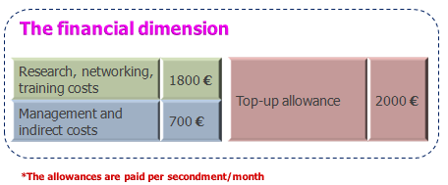
EU contribution
Staff member unit cost can be:
- Paid directly to the seconded staff member or
- Managed centrally by the beneficiary according to the specific needs of the secondment.
- Detailed arrangements for the use of the contribution may also be agreed internally between beneficiaries and partner organisations, to address the specific financial needs of each secondment.

Slide 33
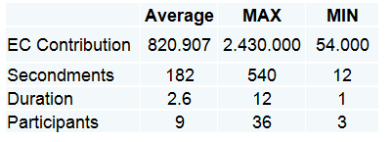
Examples from RISE 2015

Slide 34
Award Criteria
- Excellence: 50% weighting; priority 1
- Impact: 30% weighting; priority 2
- Implementation: 20% weighting; priority 3
Overall Threshold: of 70%
Evaluation

Slide 35
- Section 1: General information (including abstract)
- Section 2: Information on participants
- Section 3: Budget and Secondments tables
- Section 4: Ethics table
Evaluation
Proposal Part A (see guide for applicants):

Slide 36
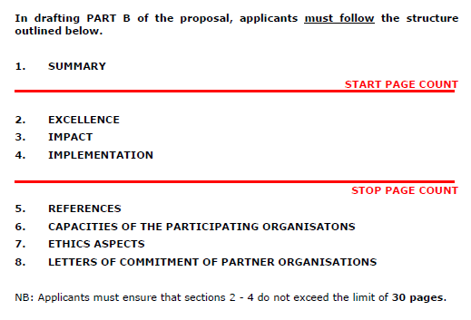
Proposal Part B (see guide for applicants):
Evaluation

Slide 37
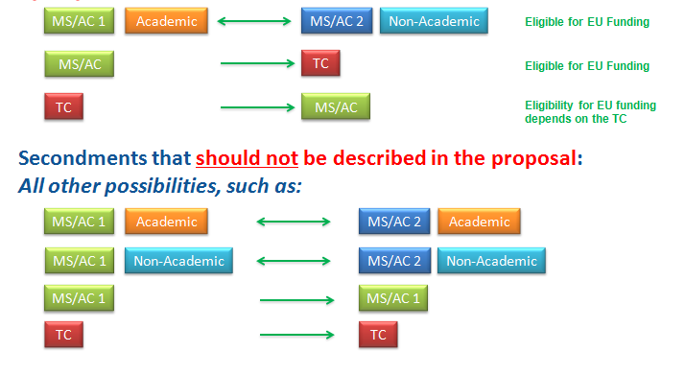
Secondments that must be described in the proposal:
Evaluation

Slide 38
Selection Criteria: operational capacity check
- Description of all participating organizations
- Description of the profile of the people who will be primarily responsible for carrying out the proposed work
- Description of any significant infrastructure or any major items of technical equipment, relevant to the proposed work
Evaluation

Slide 39
MSC actions
  Opportunities:
Open to mono-beneficiaries from MS/AC
International, national and regional programmes
Private and public organizations can apply
Projects up to 5 years
€ 10 million funding cap per applicant per call
Vacancies EURAXESS and MSCAs website
COFUND
  Funding for funders: EU/AC based organisations or International European Interest Organisations (ex.CERN) that fund or manage doctoral or fellowship programmes
The financial dimension
Management costs | 325 €
Living allowance* Early-stage researchers | 1855 €
Living allowance* Experienced researchers | 2625 €
*The living allowances are paid to the researcher per month and these amounts have to be complimented by the beneficiery

Slide 40
Which action?
http://ec.europa.eu/research/mariecurieactions/media-library/documentation/publications/index_en.htm

Slide 41
MSCAs
Expected impact
2014
2020
~ 65.000 researchers to be supported, including 25.000 PhD candidates
~ 200.000 scientific publications in high impact peer-reviewed journals
~ 1.500 patent applications
~ 100 spin-offs created
~ 350-400 new programmes at regional/national/international level targeting international and intersectoral training, and career development of R&I staff

Slide 42
MSCAs calls deadline 2016-2017
Innovative Training Networks (ITN) | 15/10/2015 – 12/01/2016 15/09/2016- 10/01/2017 | 370.00 million EUR 430.00 million EUR
Individual Fellowships (IF) | 12/04/2016 – 14/09/2016 11/04/2017- 14/09/2017 | 218.5 million EUR 248.00 million EUR
Research and Innovation Staff Exchange (RISE) | 08/12/2015 – 28/04/2016 (open) 01/12/2016- 05/04/2017 | 80.00 million EUR 80.00 million EUR
Co-funding of regional, national & international programmes (COFUND) | 14/04/2016 – 29/09/2016 05/04/2017- 28/09/2017 | 80.00 million EUR 80.00 million EUR

Slide 43
The next steps
Where to get more information?
Marie Skłodowska-Curie Actions Website
http://ec.europa.eu/msca
Horizon 2020
http://ec.europa.eu/programmes/horizon2020
Participant Portal (applications)
http://ec.europa.eu/research/participants/portal
Marie Skłodowska-Curie Alumni Association
https://www.mariecuriealumni.eu

Slide 44
The next steps
For further questions on MSCA send a message to
the Research Enquiry Service:
http://ec.europa.eu/research/index.cfm?pg=enquiries
National Constact Ponts
For help with Intellectual Property Rights (IPR):
http://ec.europa.eu/research/index.cfm?pg=enquiries
THANK YOU!

