Slide 1
Erasmus mobility at Virumaa College of TUT -
good practices and problems
Natalja Denissova
Department for Development
Virumaa College of TUT

Slide 2
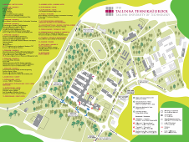
Tallinn University of Technology General
Total number of curricula: 101
Bachelor: 29
Master: 43
B+ M integrated: 3
Applied higher education: 16
Doctor: 10
Total number of students: 14 151
Employees: 2 038
Faculties: 8
Departments: 33
Centres: 9
Chairs: 108
Divisions: 6
Colleges: 4
27.05.2013
2
2

Slide 3
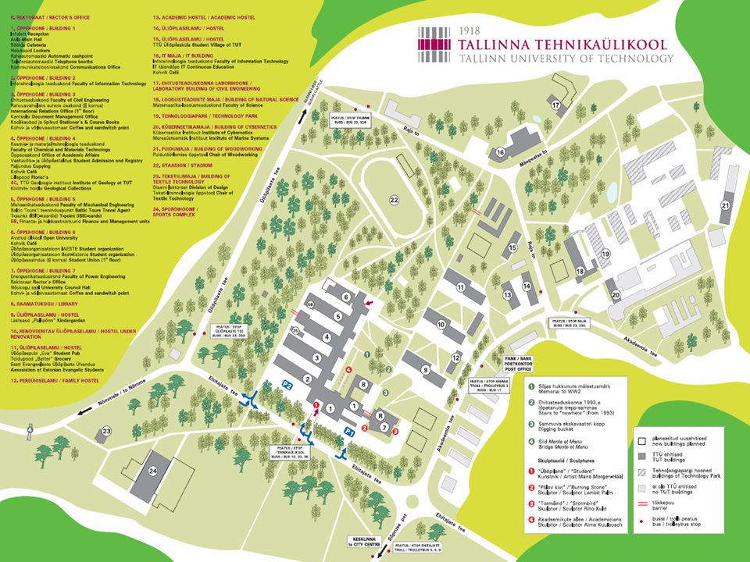
The heart of TUT campus - study area
27.05.2013
3
27/05/2013
3

Slide 4
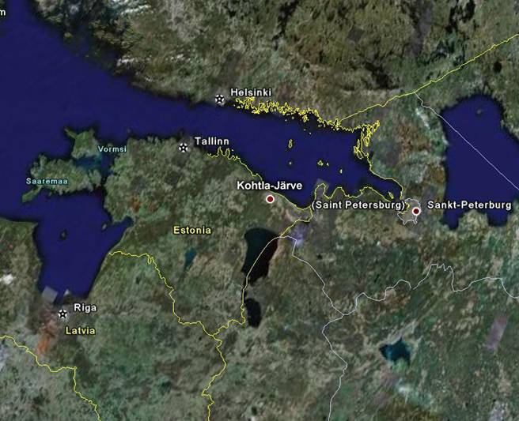

Slide 5
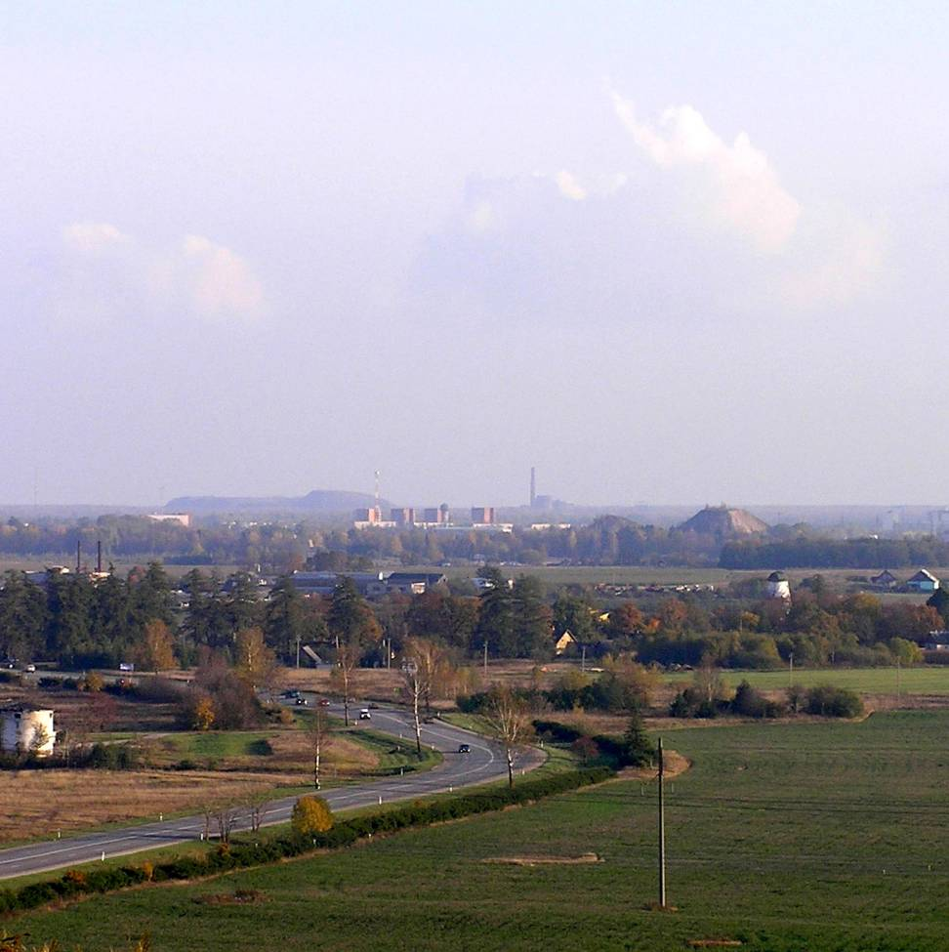

Slide 6
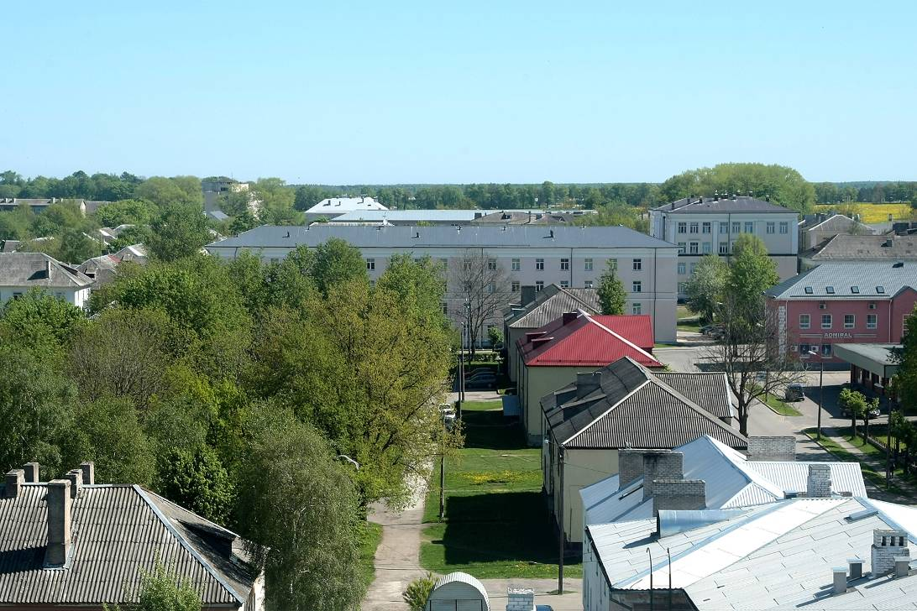

Slide 7
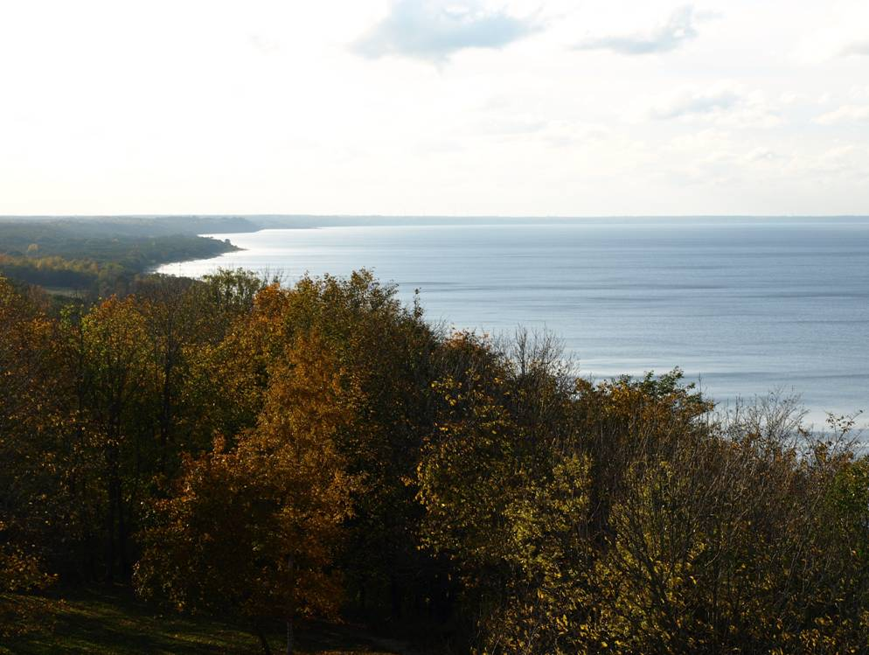

Slide 8
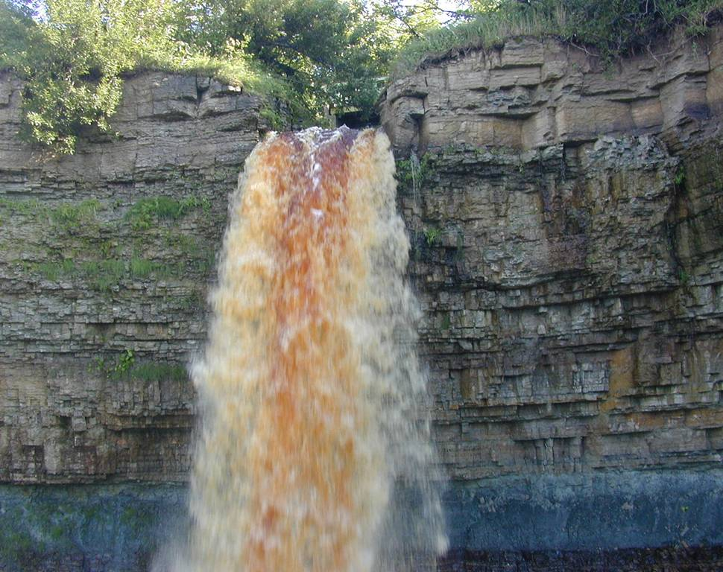

Slide 9
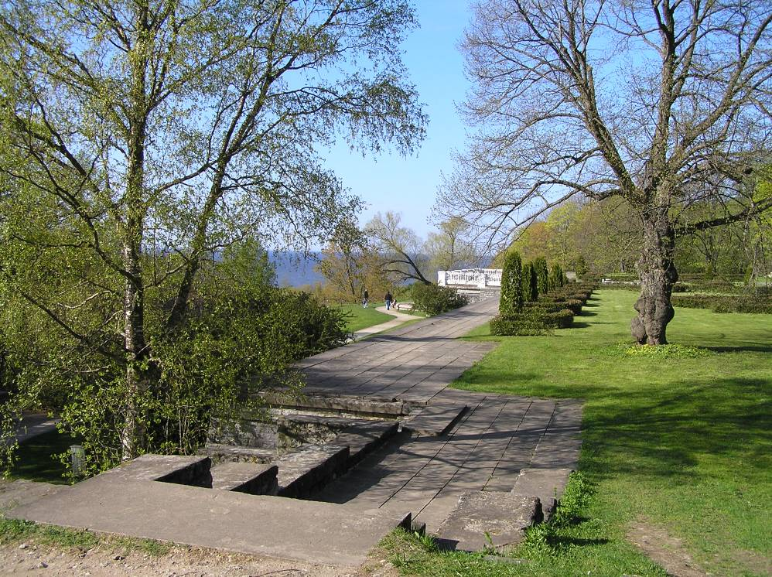

Slide 10
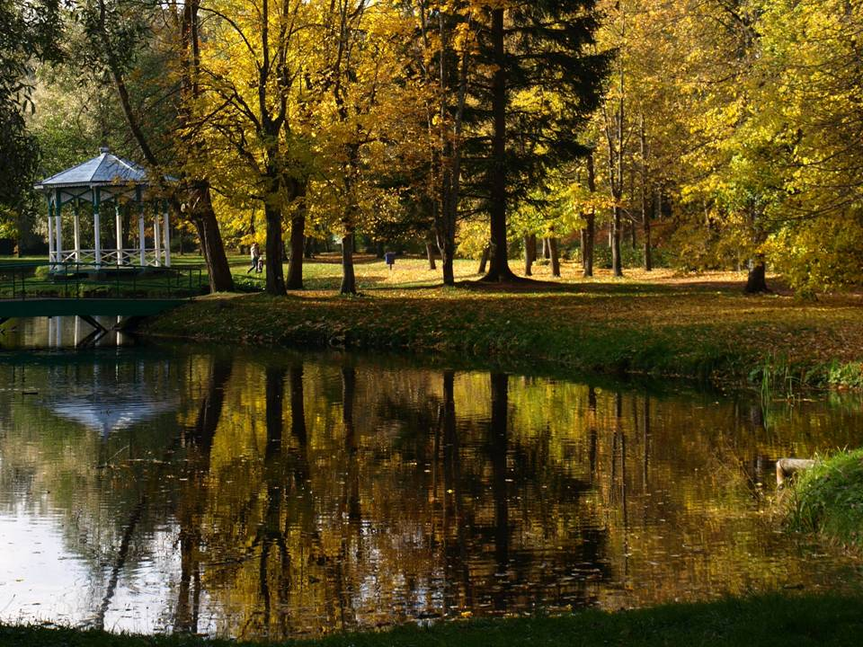

Slide 11
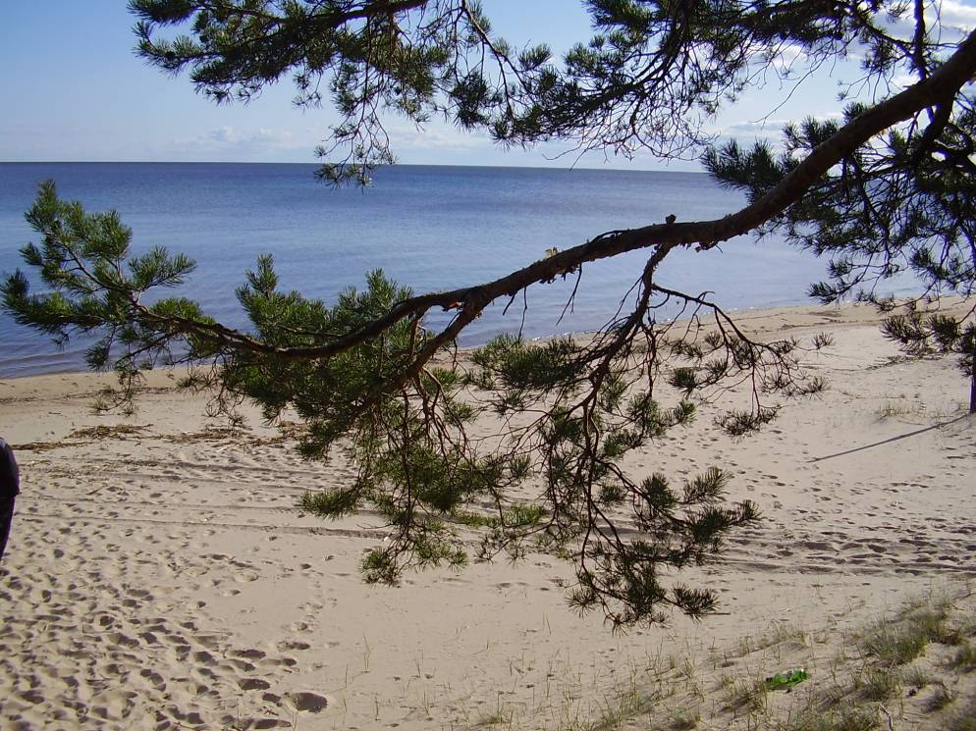

Slide 12
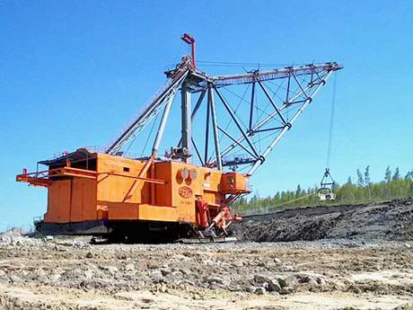

Slide 13
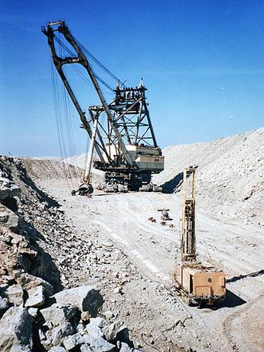
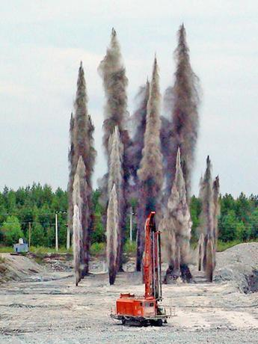

Slide 14
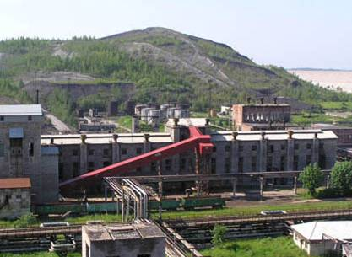

Slide 15
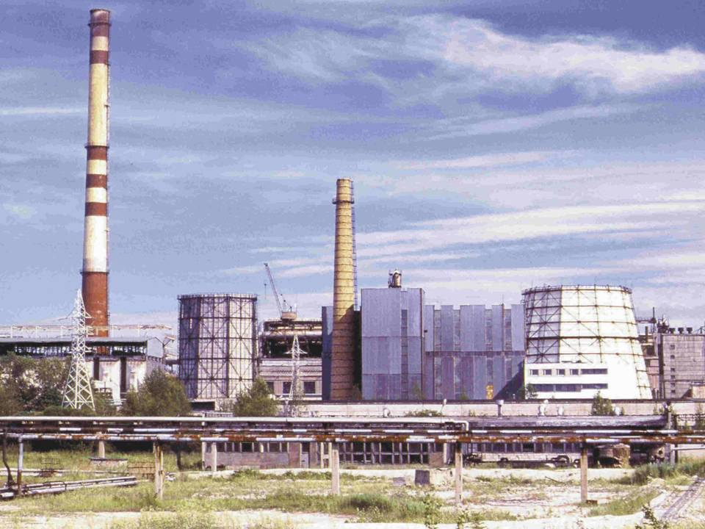

Slide 16
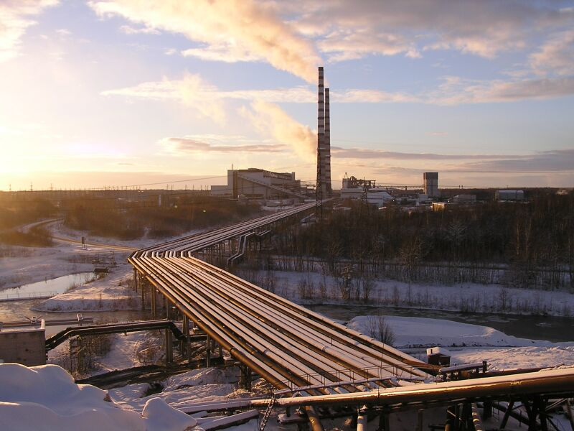

Slide 17
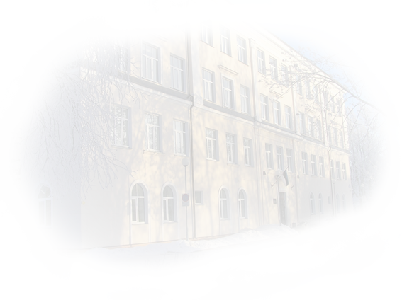
General
Virumaa College of TUT was established in 2000 year
Intake in 2012 ~ 242 students
Number of students as on 31.08.2012 - 660
Staff 101, academic staff 34

Slide 18
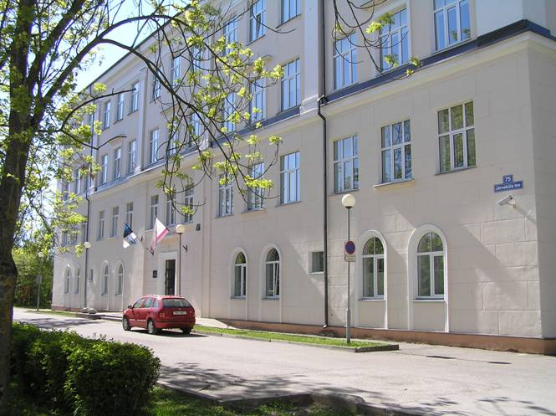
Student hostel
Premises ~ 1,8 ha
Study building

Slide 19
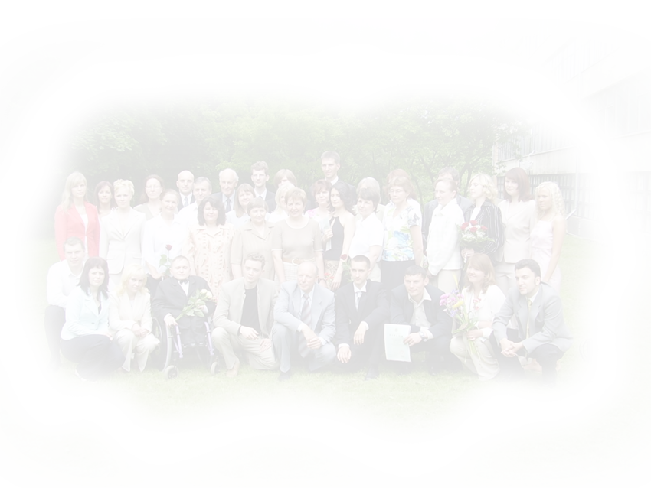
Number of students for 2000-2012

Slide 20
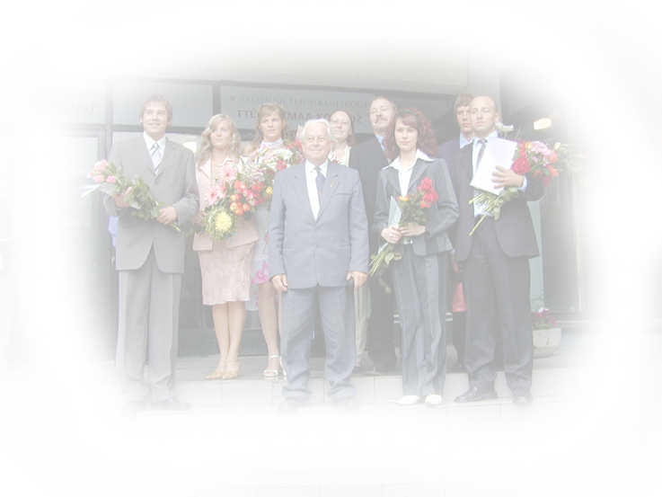
Graduates

Slide 21
Academic staff
Full-time teaching staff - 34
8 Doctors + 2 senior researchers
4 acquiring a doctor's degree
Visiting lecturers ~15

Slide 22
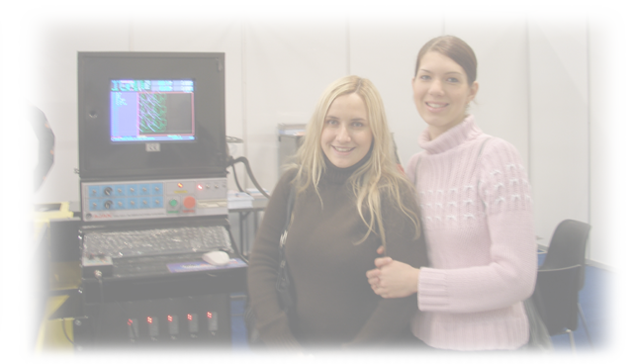
Study Programs (240 ECTS)
Machine Building Engineering
Applied Information Technology
Industrial Automation
Fuel Technology
Construction Engineering
Power Engineering
Fuels Chemistry and Engineering Master’s Curriculum Since September 2012

Slide 23
Structure of the curriculum
Study programs conformity with professional standards

Slide 24
Subjects of the Mining module (30 ECTS)
Fundamentals of geology
Drilling-and-blasting operations
Physics of rock breaking
Mining operations
Mining machines
Mine pumping, ventilation and safety
Practical training

Slide 25
Total cost of projects in 2011-2012
5 676 017€

Slide 26
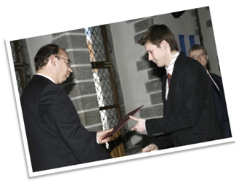
Scholarships from local partner-companies
2005-2012
195 students
117 993 €
13 companies

Slide 27
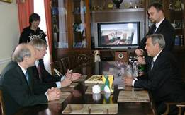
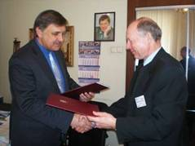
Foreign relations
Saint-Petersburg State University of Informative Technologies, Mechanics and Optics
National Mineral Resources University(Mining University),
Saint-Petersburg
University of Ruse, Bulgaria
University of Ruse, Bulgaria
Co-partners
Mid Sweden University
Mid Sweden University
Saint-Petersburg State University of Engineering and Economics
University de Picardie Jules Verne, France
University of Chemical Technology & Metallurgy, Bulgaria

Slide 28
Students mobility 2008-2013
Country | outgoing | incoming
Bulgaria | 4 | 3
France | 9 | 8
Germany | 2
Lithuania | 4 | 1
Poland | 1
Russia * (each year) | 10 | 10
Sweden | 6
Total | 36 | 22

Slide 29
Good practices of Erasmus mobility
reliable and quick communication between partners
moveonnet.eu system
coordinators meetings in IRO
info-hour for the students
inviting outgoings to info-hour for sharing experience
visiting study groups by coordinator
individual consulting when selecting universities/subjects
support from academic staff

Slide 30
Problems of Erasmus mobility
students passiveness
LA withdrawal
delayed replies from partners
difficulties when searching for information on a partner site
absence of "buddy" system in the college
few placements

Slide 31
Laboratory facilities
19 laboratory rooms (976,7 m²)
more than 30 laboratory works
total cost of the equipment ~1,6 mill EUR
2 senior researchers, 5 chemical engineers, 2 technical specialists, 4 laboratory assistants

Slide 32
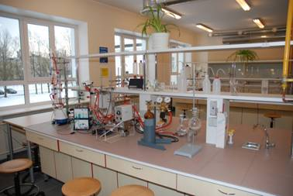
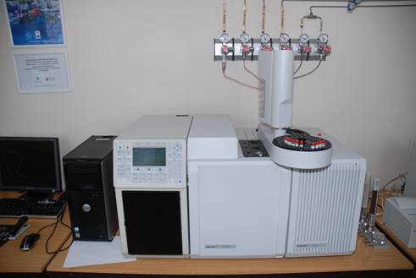
Fuel Technology

Slide 33
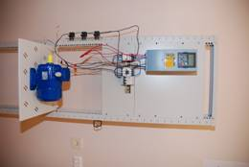
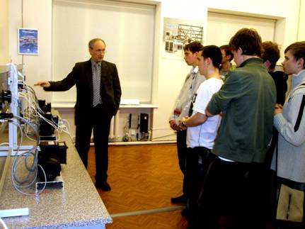
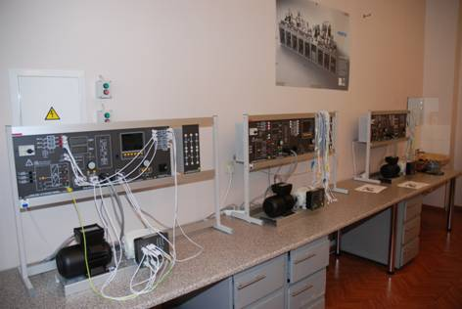
Power Engineering

Slide 34
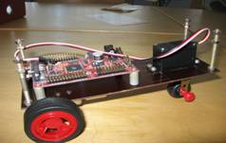
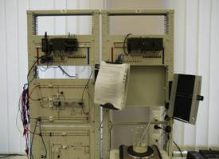
Industrial Automation

Slide 35
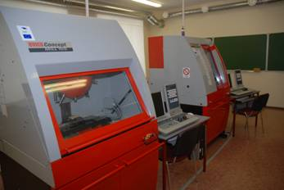
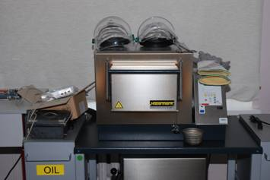
Machine Building Engineering

Slide 36
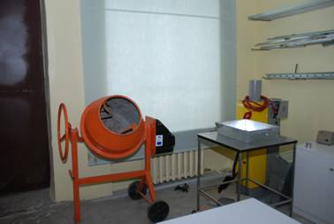
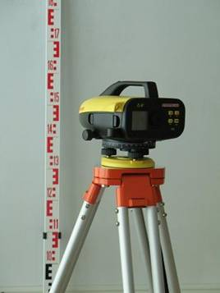
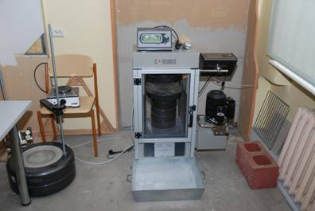
Construction Engineering

Slide 37
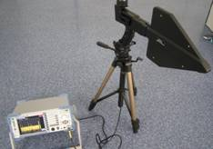
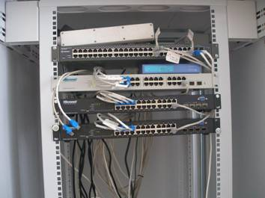
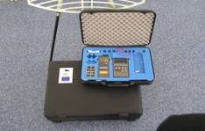
Applied Information Technology

Slide 38
Canteen (80-100 places)

Slide 39
Student hostel
4155,2 m²
renovated in 2008
52 double rooms for students
6 rooms for guest lecturers
2 lecture halls
fitness hall
sauna
laundry room

Slide 40
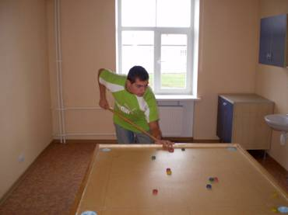
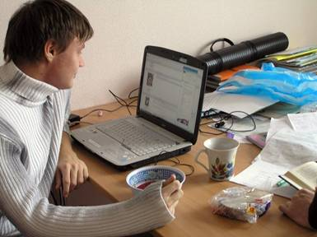
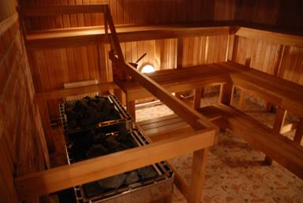
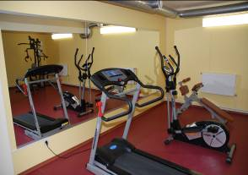
Student hostel

Slide 41
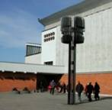
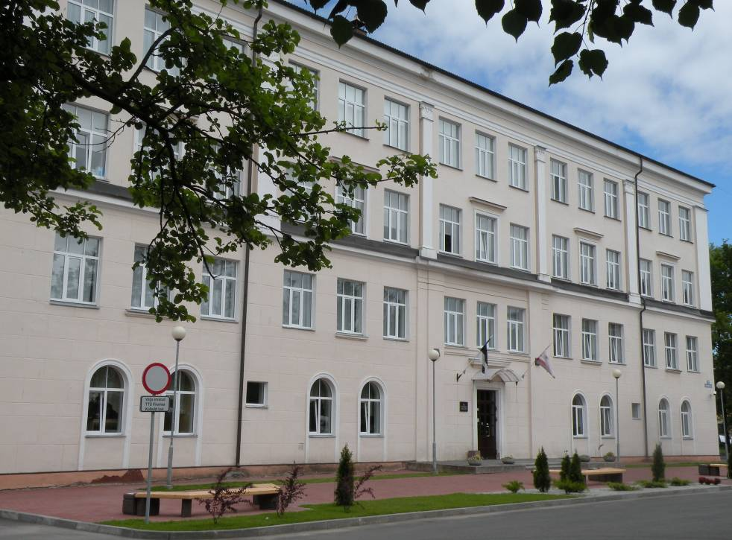
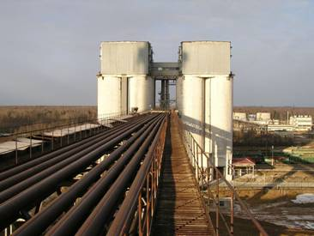
Efficient education!

Slide 42
Thank you for your attention!

